Slide 1
Secure Data Hiding in Image Using Steganography
CAPSTONE PROJECT
Presented By
Student Name : SREENITHI GANESH
College Name : Hindustan Institute Of Technology And Science
Department : M.TECH[CSE]

Slide 2
OUTLINE
Problem Statement
Technology used
Wow factor
End users
Result
Conclusion
Git-hub Link
Future scope

Slide 3
Problem Statement
In today's digital world, secure communication is crucial. Traditional encryption methods make data unreadable but can attract attention. Steganography hides information within images, making it undetectable. This project focuses on embedding and extracting secret messages from images, ensuring safe and discreet data transmission.

Slide 4
Technology used
Programming Language: Python
Libraries: OpenCV (cv2), NumPy, OS
Platform: Jupyter Notebook / Python IDLE
Concepts: Image Processing, Least Significant Bit (LSB) Steganography

Slide 5
Wow factors
Invisible Data Hiding: The message is embedded within the image pixels without altering its appearance.
Password Protection: Ensures that only authorized users can retrieve the hidden message.
Custom Encryption: Uses pixel manipulation for secure encoding and decoding.
Lightweight & Efficient: No need for external servers; runs locally with minimal resources.

Slide 6
End users
Cybersecurity Professionals – To securely transmit sensitive information.
Journalists & Whistleblowers – To protect confidential sources and data.
Government & Military Agencies – For secure communication without detection.
Individuals & Organizations – To safeguard personal or business information.

Slide 7
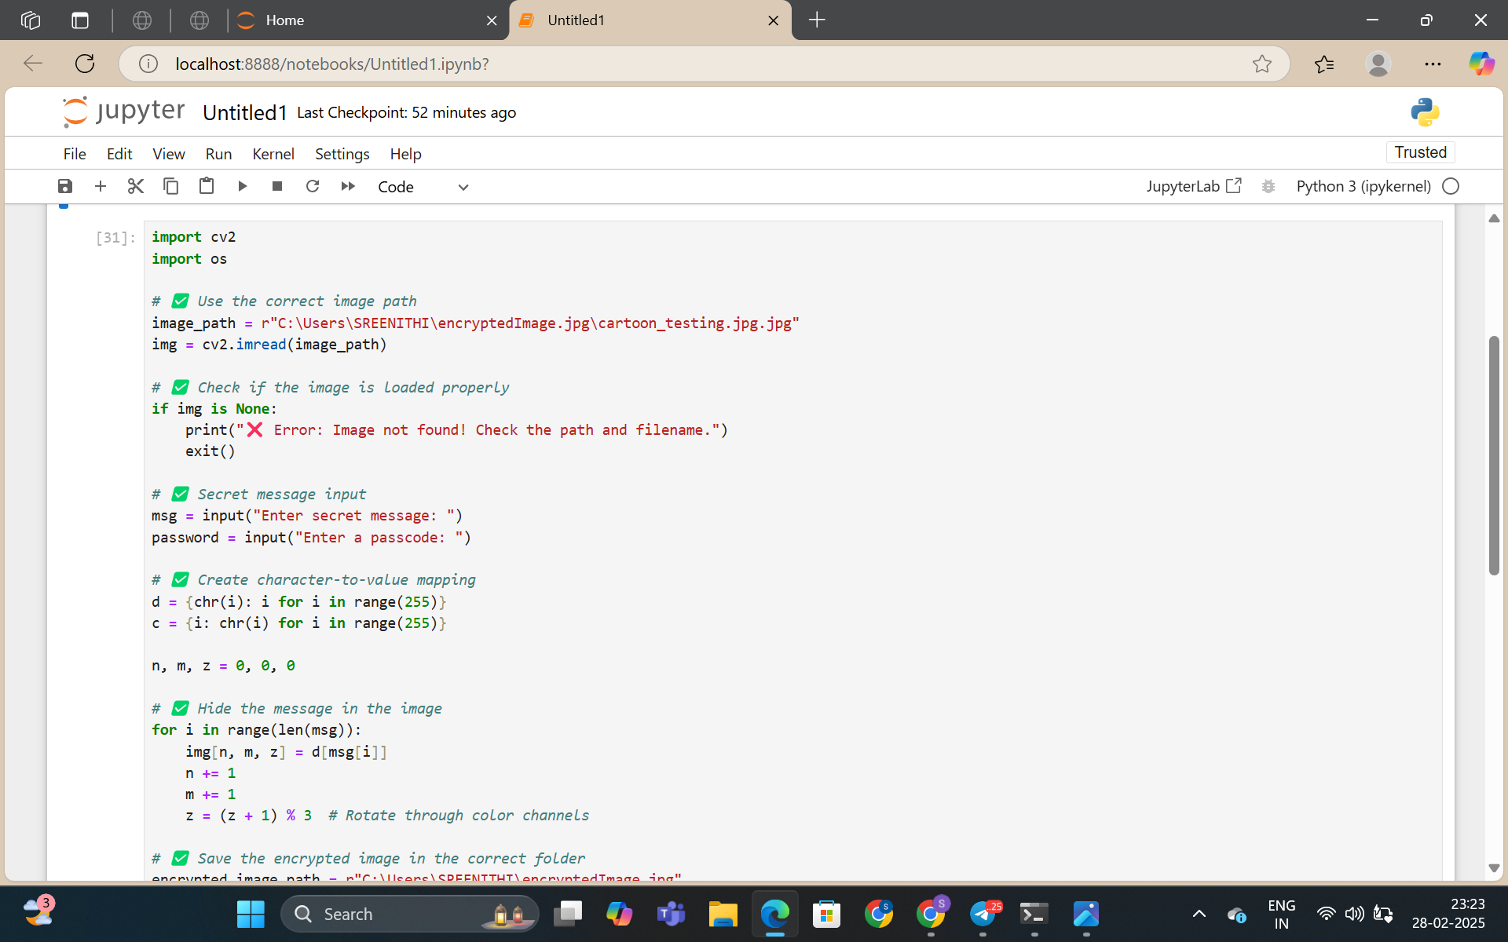
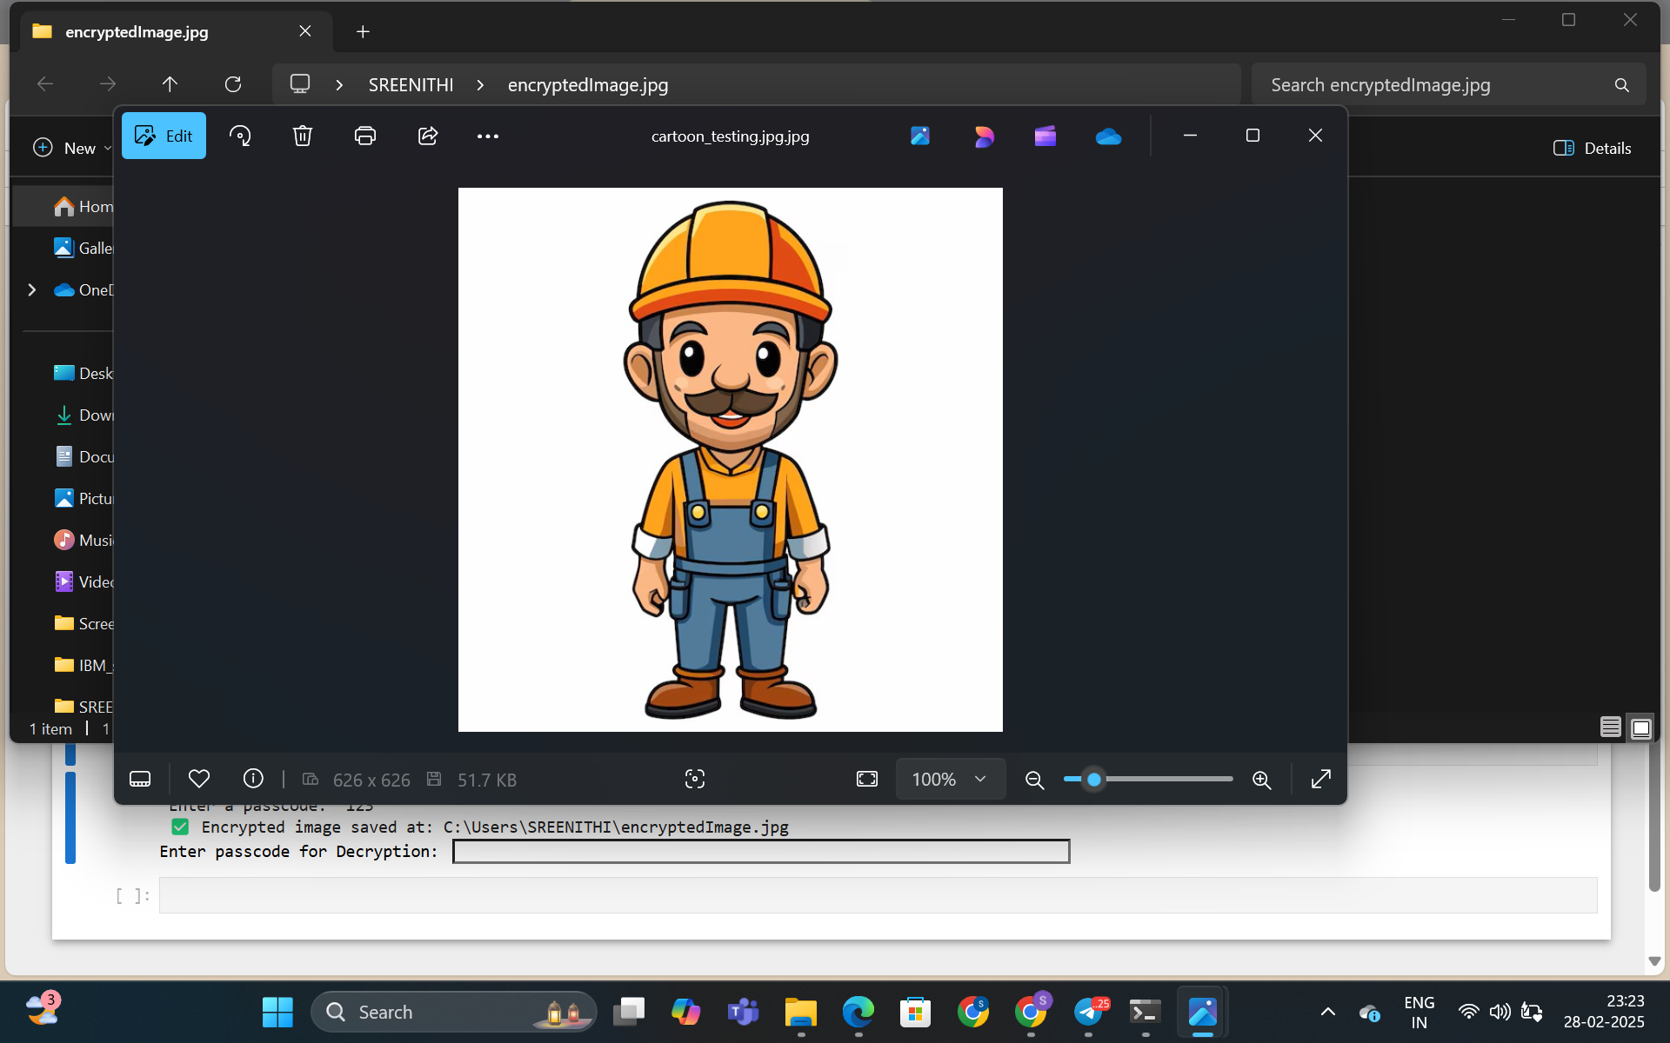
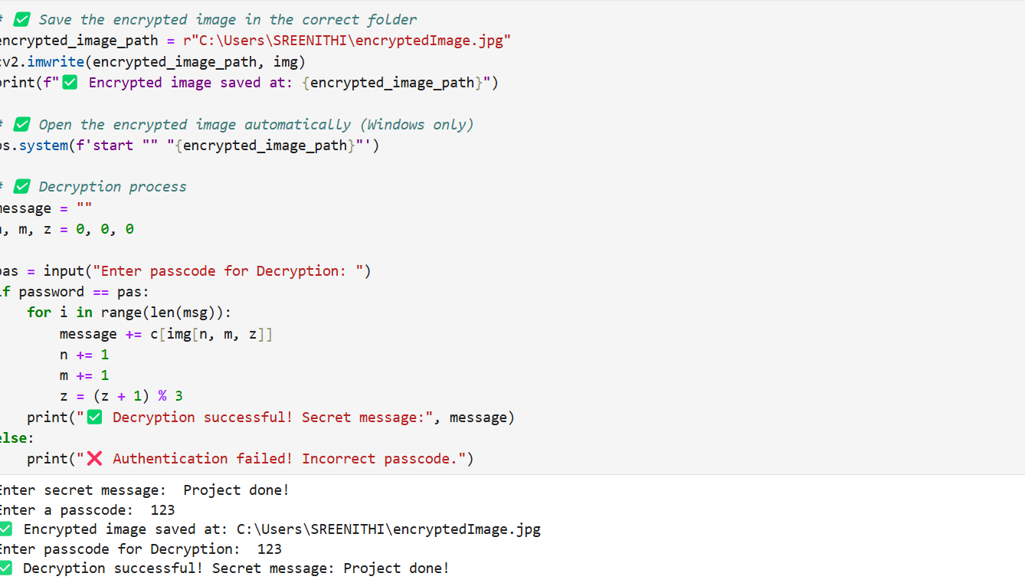
Results

Slide 8
Conclusion
Successfully implemented a simple steganography technique.
Text was embedded and retrieved from an image securely.
Enhanced security by using a passcode-based authentication.

Slide 9
GitHub Link
https://github.com/SREENITHIGANESH/AICTE_Project_Cyber

Slide 10
Future scope(optional)
Using advanced LSB (Least Significant Bit) techniques for better data hiding.
Implementing AES encryption for additional security.
Developing a GUI-based tool for user-friendly interaction.

Slide 11
THANK YOU!!

